Slide 1
Sales data analysis
By Keshav sharma

Slide 2
objective
To contribute the success of a business by utilizing data analysis techniques, specifically focusing on Profitability Analysis and Exploratory Data Analysis (EDA) to provide valuable insights and accurate sales forecasting.

Slide 3
description
The objective can be broken down into the following detailed components:
Data Analysis: Provide valuable insights to business entities regarding the effectiveness of their sales strategies through visualization and charts.
Dashboard Creation : Identify the KPIs, design an intuitive and visually appealing dashboard, add interactive visualizations and filtering capabilities to allow users to explore the data at various levels of granularity.
Actionable Insights and recommendations: End goal is to share valuable insights and actionable information that can drive strategic decision making and support the company’s goal for growth, efficiency and customer satisfaction.

Slide 4
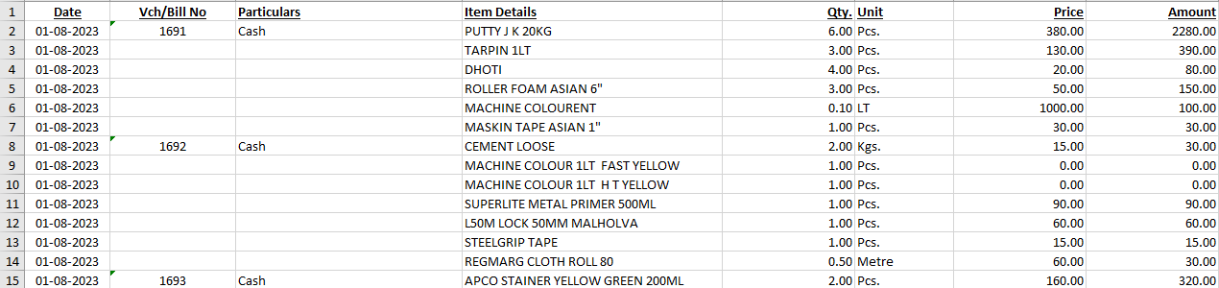
overview of the dataset

Slide 5
Technologies and Tools Used:
Microsoft Excel:
Utilized Microsoft Excel for initial data exploration, importing, and basic data manipulation.
Python for Data Analysis:
Employed Python, along with libraries such as Pandas, NumPy, and Matplotlib, for in-depth data analysis and manipulation.
Conducted Exploratory Data Analysis (EDA) using Jupyter Notebook for data visualization and statistical analysis.
Executed data preprocessing tasks, including handling missing values.
Applied machine learning algorithms for predictive analysis and insights generation.
Power BI for Visualization:
Leveraged Power BI for advanced data visualization and interactive dashboards.
Created visually appealing charts, graphs, and reports to present key findings and insights.
Enabled stakeholders to interact with the data and explore it dynamically.

Slide 6
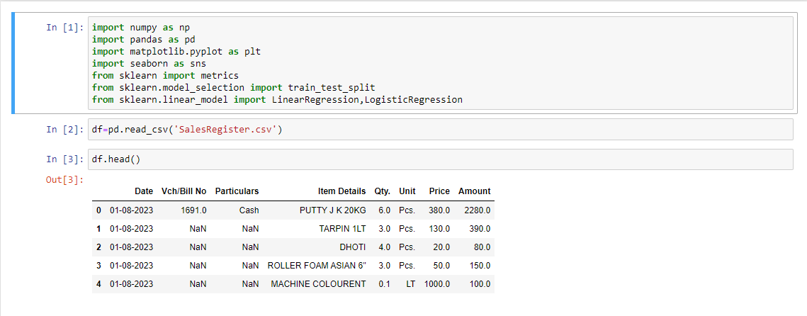
Data Preparation
Importing Libraries and making and importing csv file.

Slide 7
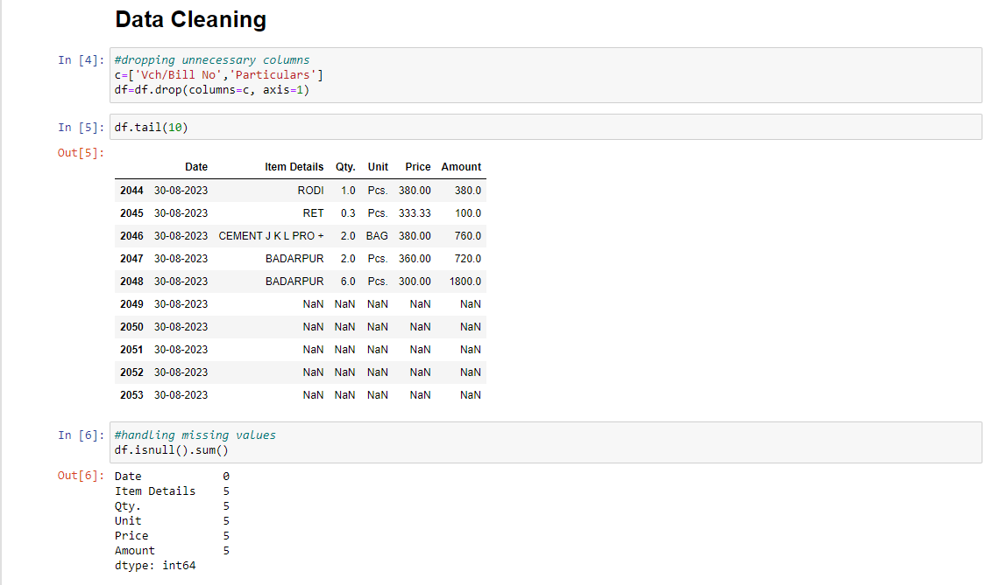
Data pre-processing

Slide 8
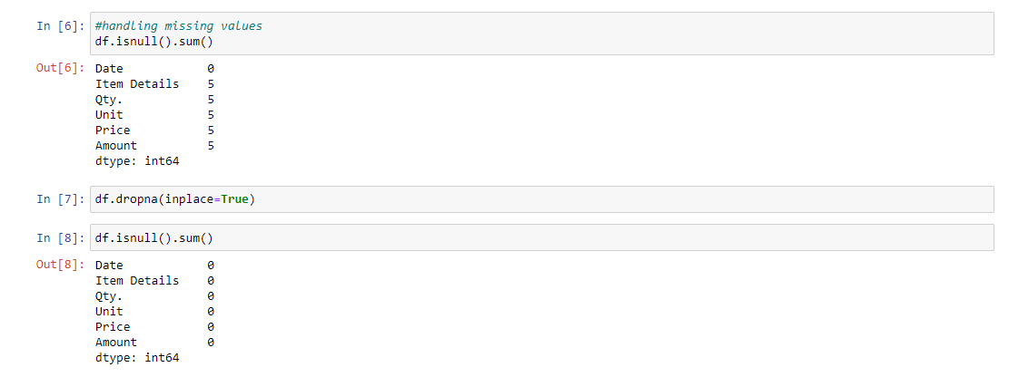
Data cleaning

Slide 9
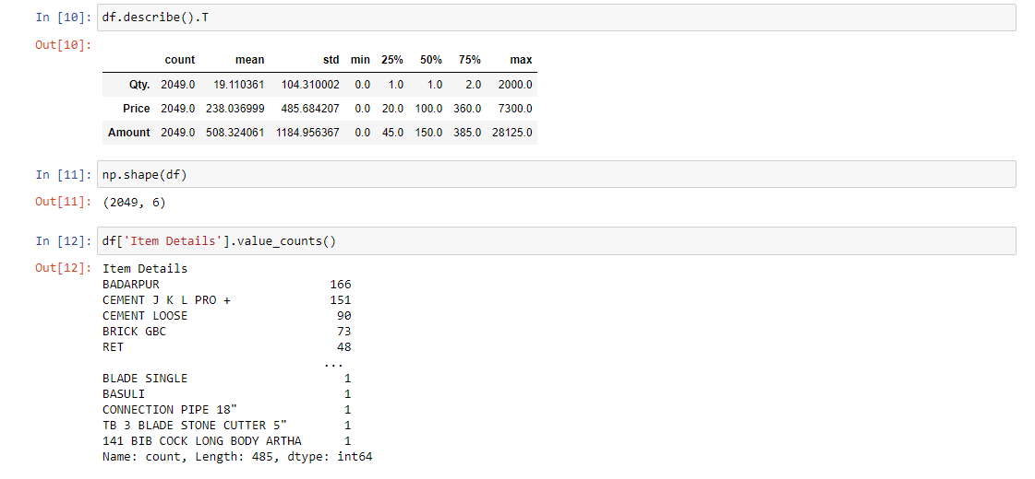
Data analysis

Slide 10
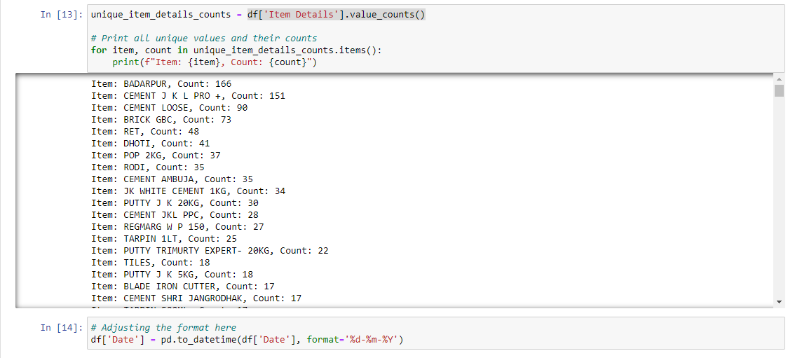
Data analysis

Slide 11
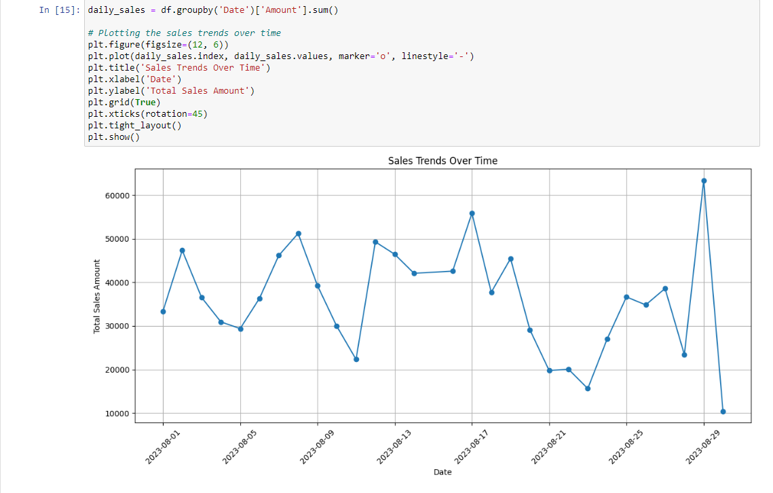
Sales trends over time

Slide 12
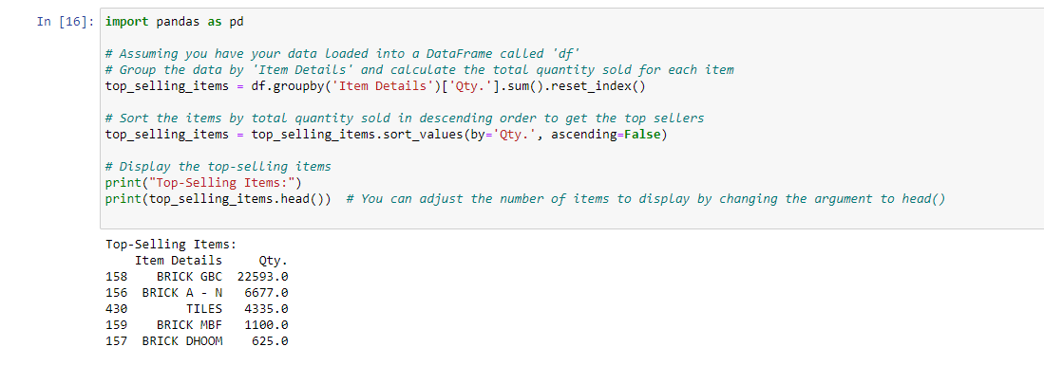
Top 5 most selling items by quantity

Slide 13
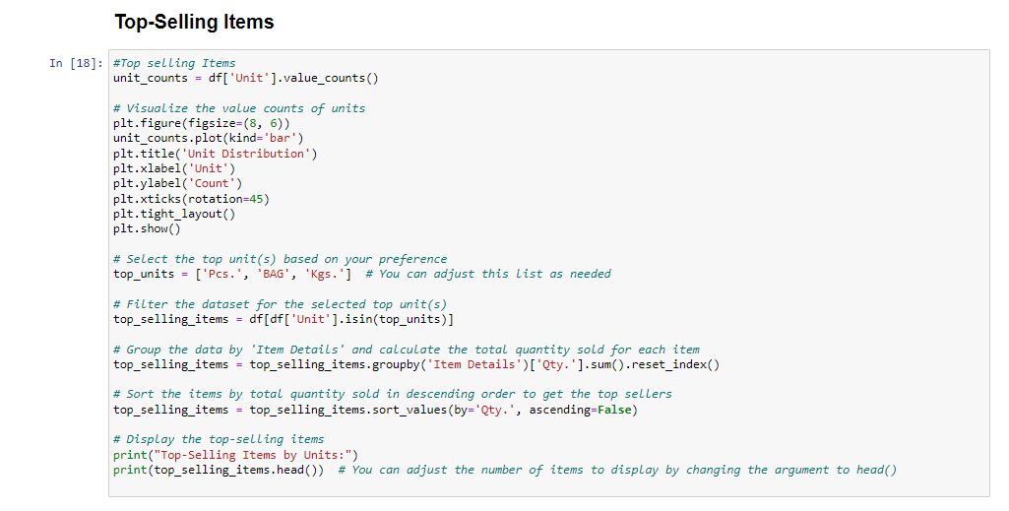
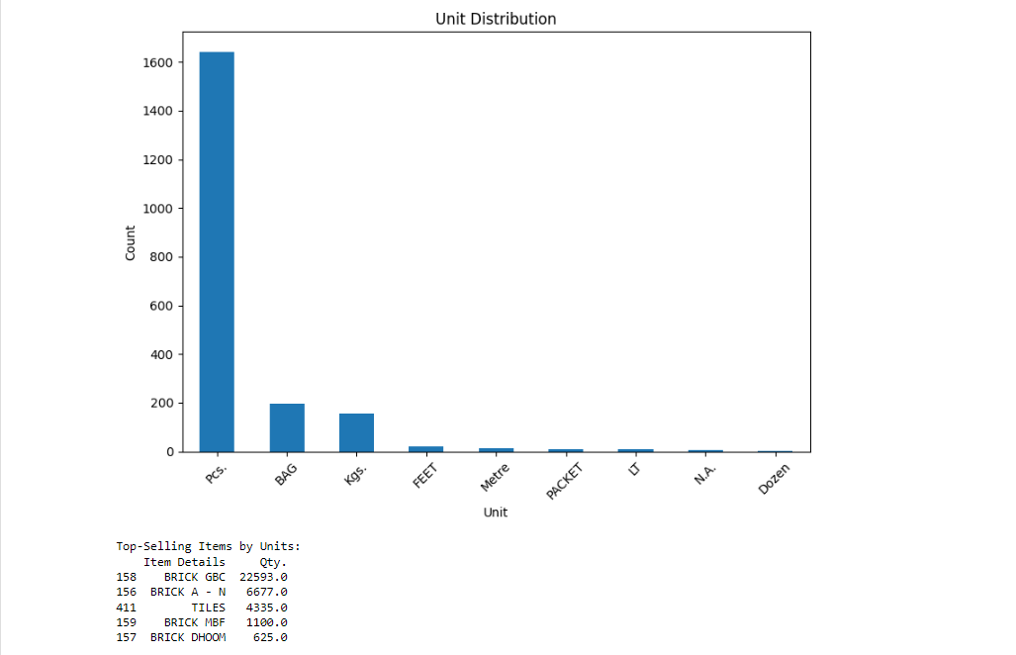
Top selling items by units

Slide 14
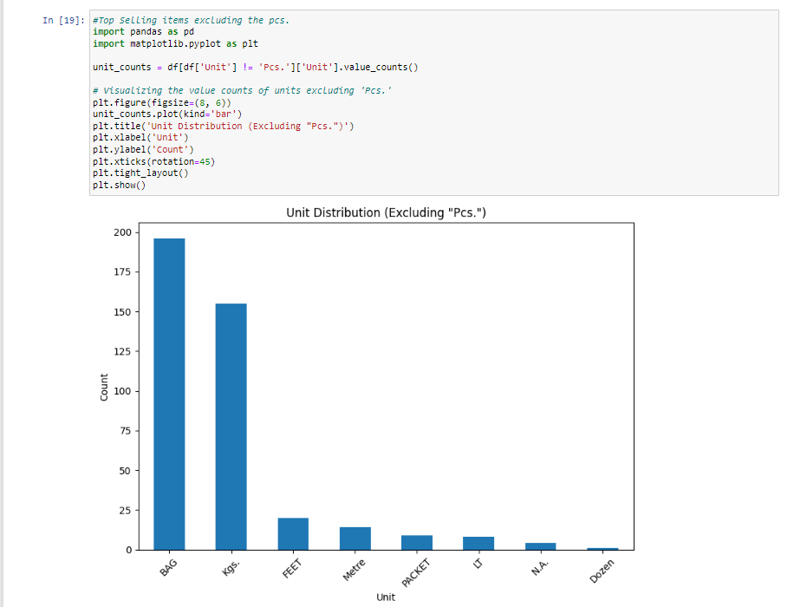
Top selling items excluding “pcs.”

Slide 15
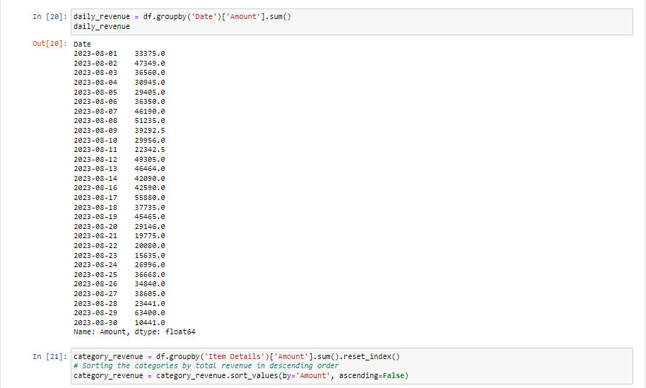
Revenue analysis

Slide 16
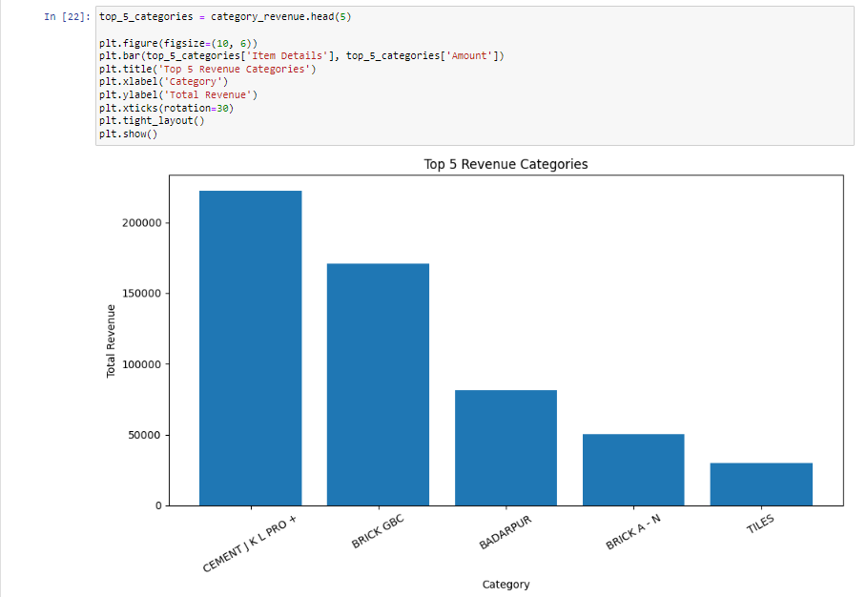
Visualizing revenue by top 5 revenue categories

Slide 17
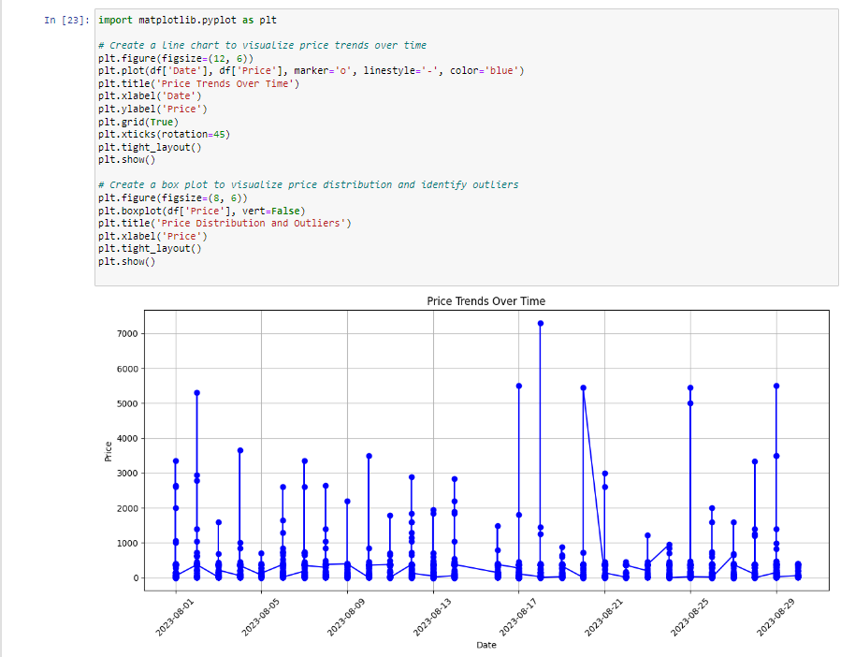
Prize trends over time

Slide 18
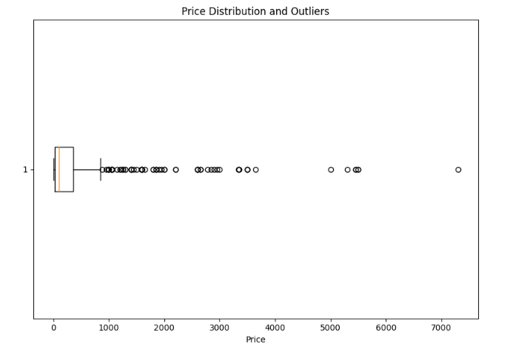
Price distribution and outliers

Slide 19
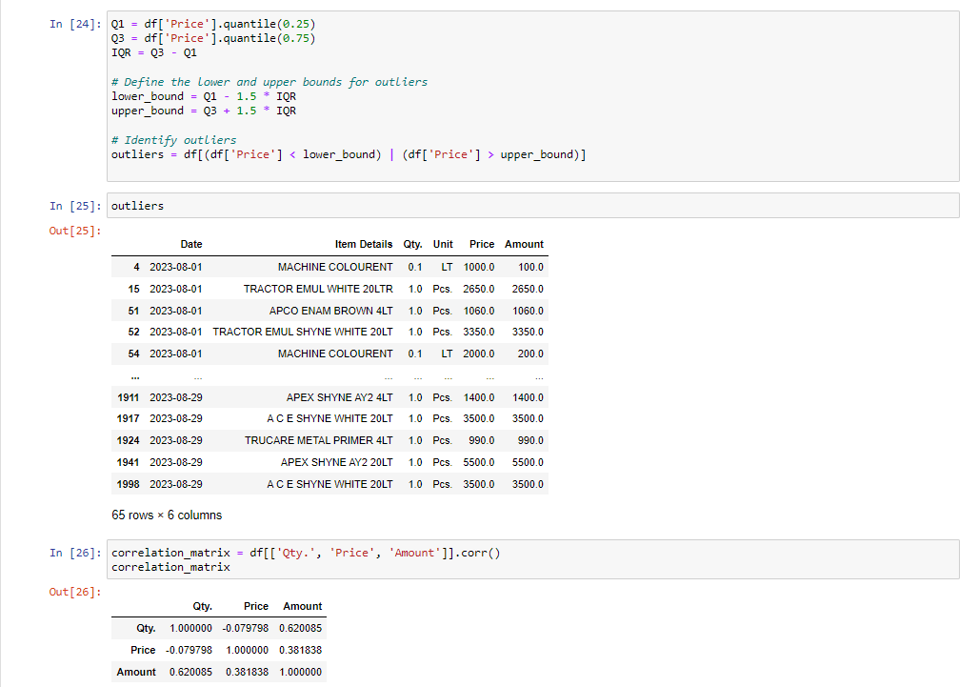
outliers

Slide 20
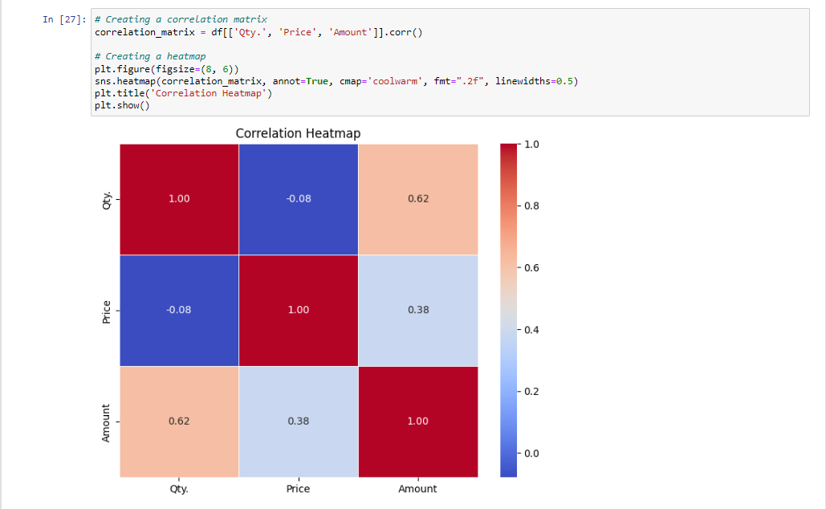
Correlation heatmap

Slide 21
Correlation heat map Analysis
1) Qty. vs. Price
The correlation between 'Qty.' and 'Price' is approximately -0.079798, which indicates a weak negative correlation. This suggests that there's a slight tendency for the quantity sold ('Qty.') and the price of the item ('Price') to move in opposite directions, but the correlation is not strong.
2) Qty. vs. Amount
The correlation between 'Qty.' and 'Amount' is approximately 0.620085, which indicates a moderate positive correlation. This means that there is a moderate tendency for the quantity sold ('Qty.') and the total sales amount ('Amount') to move together, with an increase in quantity sold associated with an increase in the total sales amount.
3) Price vs. Amount
The correlation between 'Price' and 'Amount' is approximately 0.381838, indicating a moderate positive correlation. This means that there is a moderate tendency for the price of the item ('Price') and the total sales amount ('Amount') to move together, with an increase in price associated with an increase in the total sales amount.
These correlation coefficients provide insights into the relationships between the variables in the data.

Slide 22
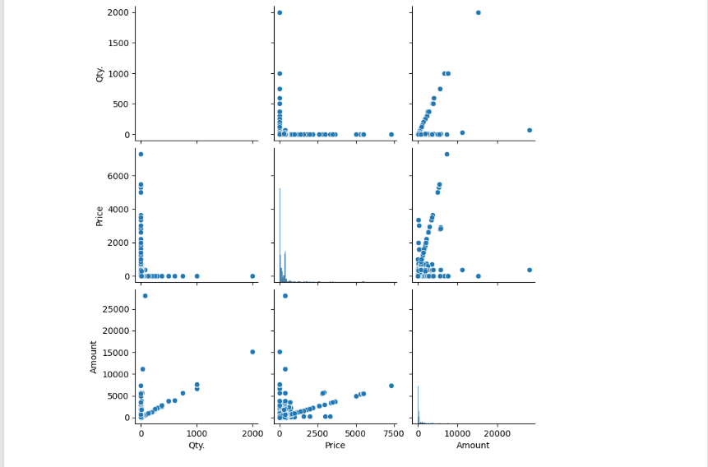
visualising using Scatter matrix

Slide 23
Profitability analysis
The primary objective was to assess the profitability of each item in our inventory, assuming a 20% profit margin. This analysis is crucial for making informed decisions regarding pricing, product management, and overall business strategy.
Methodology:
Profit Margin: We calculated the profit for each item by applying a 20% profit margin to the 'Amount' column in our dataset. The profit margin represents the portion of revenue that contributes to profit after covering costs.

Slide 24
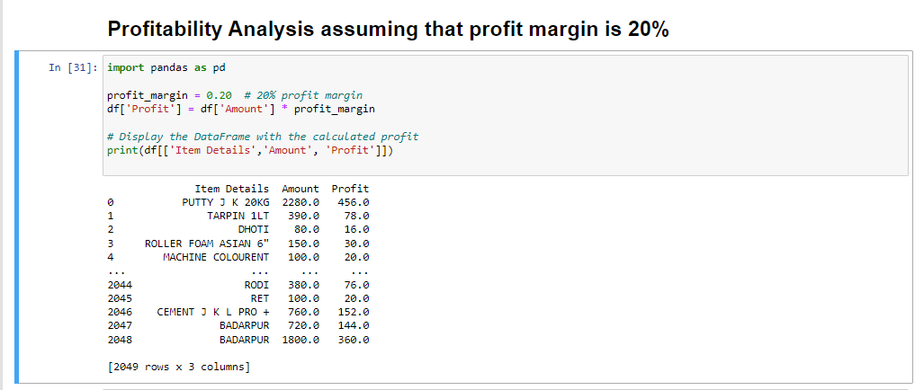
results

Slide 25
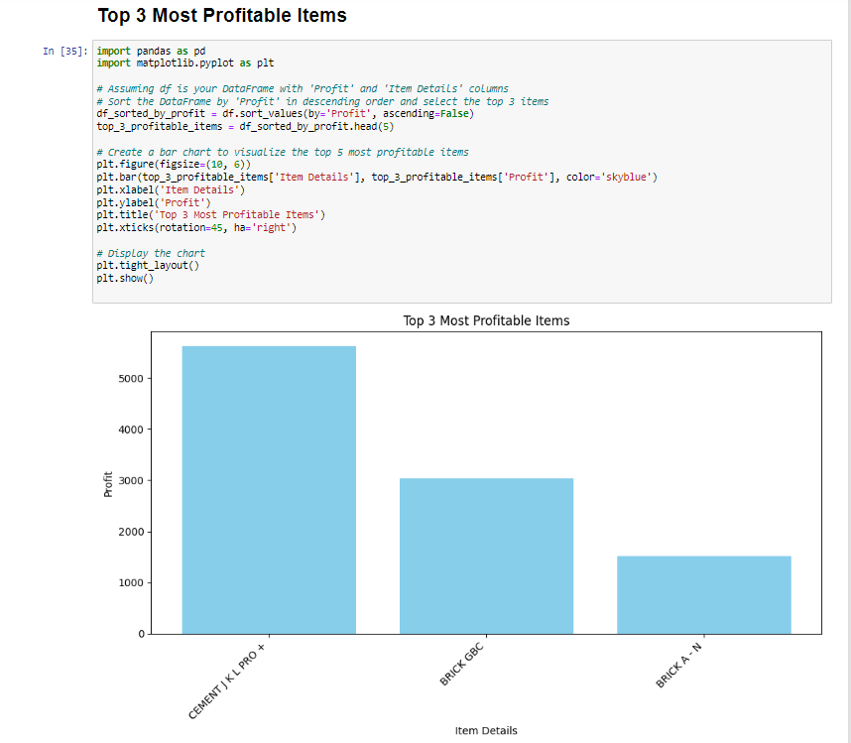
Top 3 most profitable items

Slide 26
Key insights
With this profitability analysis, we are better equipped to make informed decisions regarding pricing strategies, product promotions, and inventory management. We can identify products with higher profit margins and focus our efforts accordingly.
The profitability analysis has provided valuable insights into the financial performance of the products. It serves as a foundation for data-driven decision-making, enabling and optimizing the pricing strategies and enhance overall profitability. Moving forward, we will continue to monitor and analyze profitability to adapt to changing market conditions and business objectives.

Slide 27
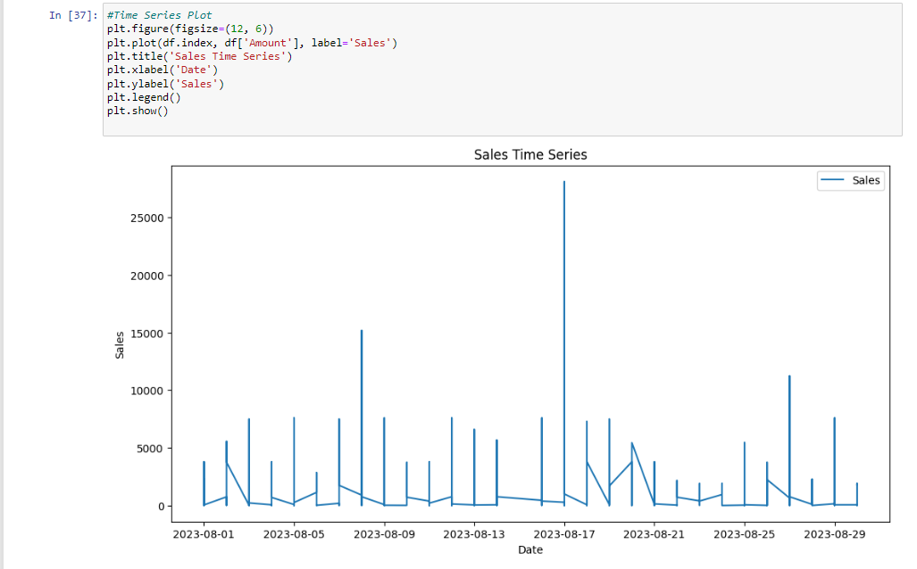
Time-series plot

Slide 28
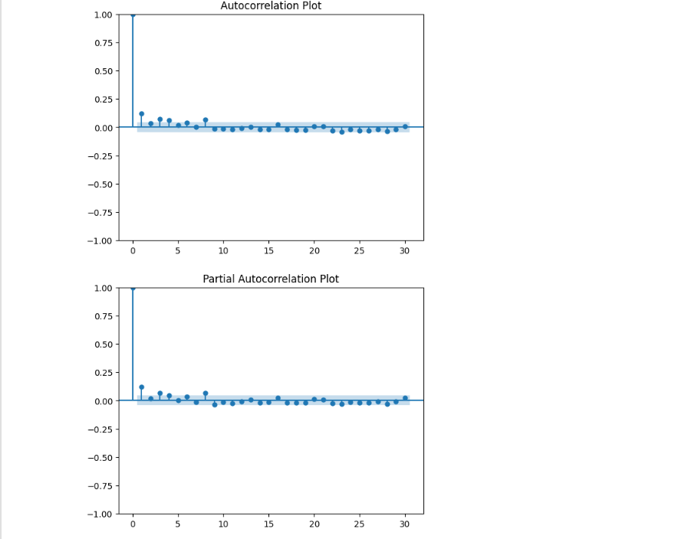
autocorrelations plots

Slide 29
Regression analysis
Model Used: Decision Tree Regression model.
Decision Tree Regression is a supervised machine learning technique used for predicting a continuous target variable based on one or more input features. It is a versatile and interpretable model that builds a tree-like structure to make predictions.
Advantages:
Interpretability: Decision Trees are easy to interpret and explain. You can visualize the tree structure and understand the decision-making process.
Nonlinearity: Decision Trees can capture nonlinear relationships between features and the target variable, making them suitable for complex datasets.
Handling Multicollinearity: Decision Trees can handle multicollinearity (correlations between independent variables) effectively.

Slide 30
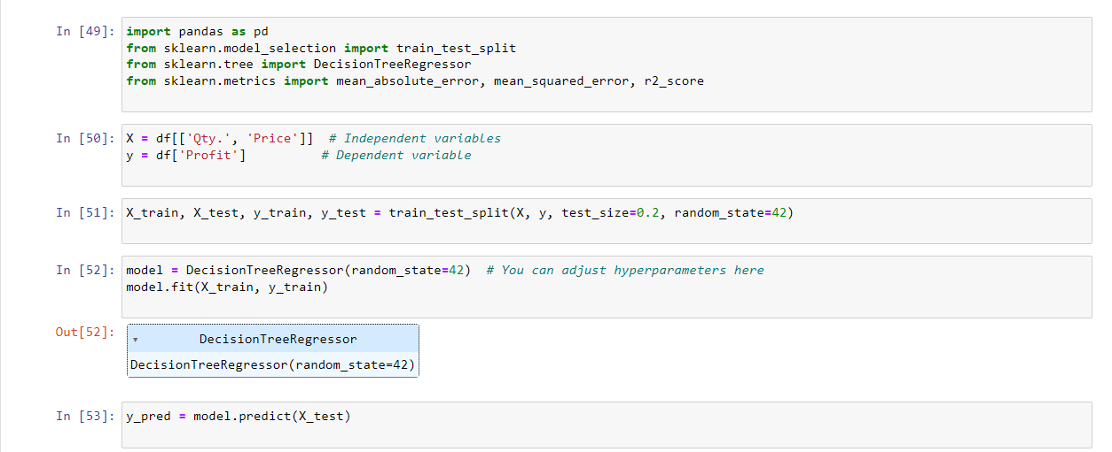
Implementing the model

Slide 31
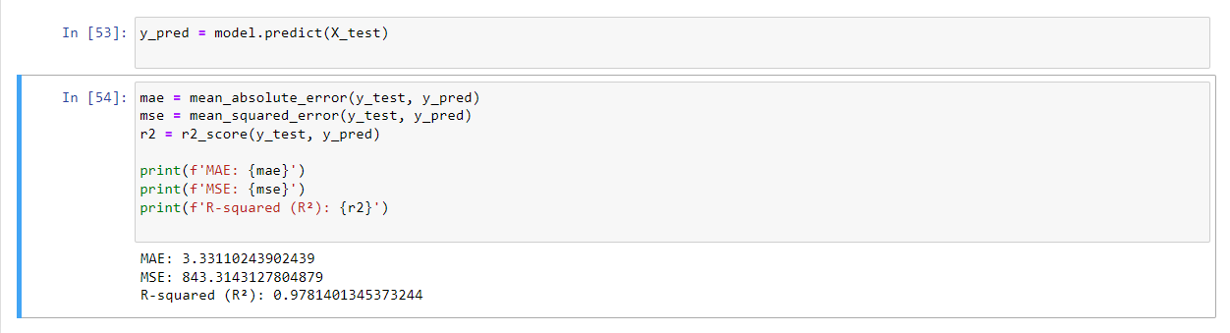
predictions

Slide 32
Conclusion
Decision Tree Regression model achieved impressive results, as indicated by the low MAE, MSE, and high R-squared values. This suggests that the model effectively captures the relationships between the quantity, price, and profit, making it a suitable choice for predicting profit based on these features.

